Slide 1
Biol 111
Discussion 2
Evolutionary Enigmas

Slide 2
Website…
Questions about expectations for learning?
  Content lectures---I expect some independent learning! Always review content lectures.

Slide 3
Goals of discussion
How are Trees of life constructed?
What is decent with modification?
Why are comb jellies hard to understand with regard to animal evolution?

Slide 4
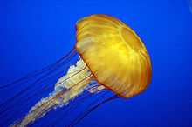
Jelly fish

Slide 5
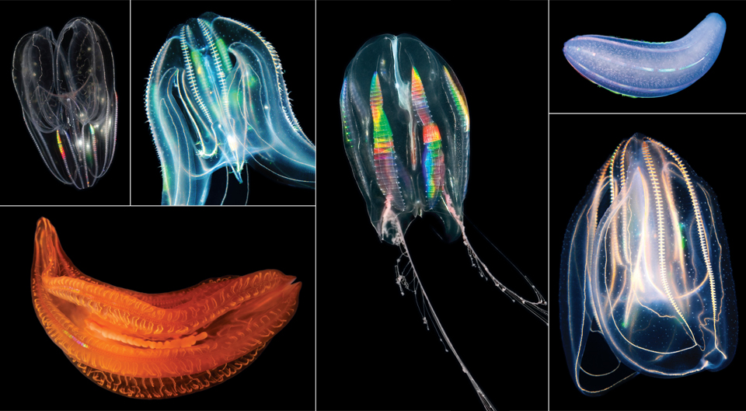
Comb Jellies

Slide 6
Comb Jellies appear in many ways to be more “advanced” than jelly fish.
Primitive nervous system, a rudimentary brain, light sensing cells…

Slide 7
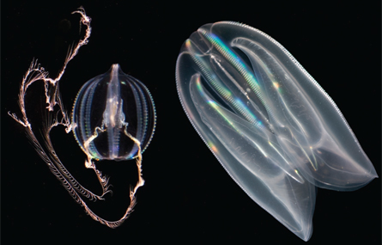
Visual analysis

Slide 8
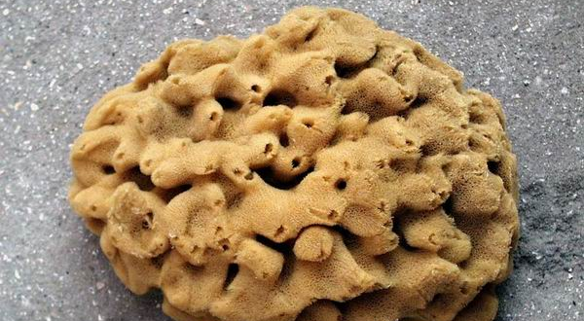
Sponge vs. comb jelly which seems more complex?

Slide 9
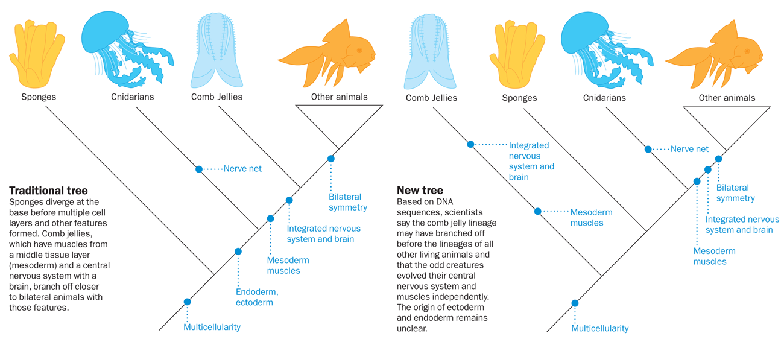
Accepted tree of life for animals

Slide 10
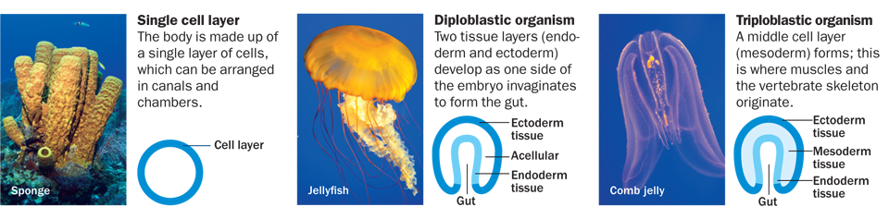
Tissue analysis

Slide 11
DNA analysis
You can compare to “looking in the box”.
Something you may observe in an animal, may seem similar (a trait that existed before, but was modified)…but may have be constructed in a different way.

Slide 12
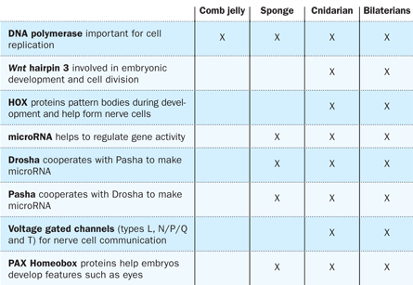
DNA analysis

Slide 13
Comb jellies don’t have the genes (DNA) you would expect them to have the structures they seem to have.
Genetically they seem more primitive than even the sponges!

Slide 14
Possible, new tree of life for animals

Slide 15
Some take home messages?
Good science is open minded. If new technology allows us to get closer to “looking in the box” we should not ignore new findings!
Good science does not throw out all other evidence. It finds a way to try to explain something that doesn’t fit an strongly supported hypothesis.

Slide 16
Comb jellies…
Might lead to major new discoveries about how complex structures are made!
Nervous systems may have more than one way of developing!
Cool stuff!

Slide 17
Re-read this paper soon!
Summarize the findings…
Think about the scientific method.
Think about the process of science….

